Slide 1
3D Image Segmentation and Quantification of Lysosomes
Comparison manual.VS. automatic
4/12/2025

Slide 2
FILES
40A_UAS-TMEM1923x-HA x 71G10 40A MARCM_L3_1_Airy_010724
TMEM-HA 6h CB airy_3_170722
40A_UAS-TMEM192-3xHA x 40A 71G10 MARCM_around 12h - for quantification_4 Airy-CBs_300425
40A_UAS-TMEM192-3xHA x 40A 71G10 MARCM_around 12h - for quantification_3 Airy-CBs_300425

Slide 3
40A_UAS-TMEM1923x-HA x 71G10 40A MARCM_L3_1_Airy_010724

Slide 4
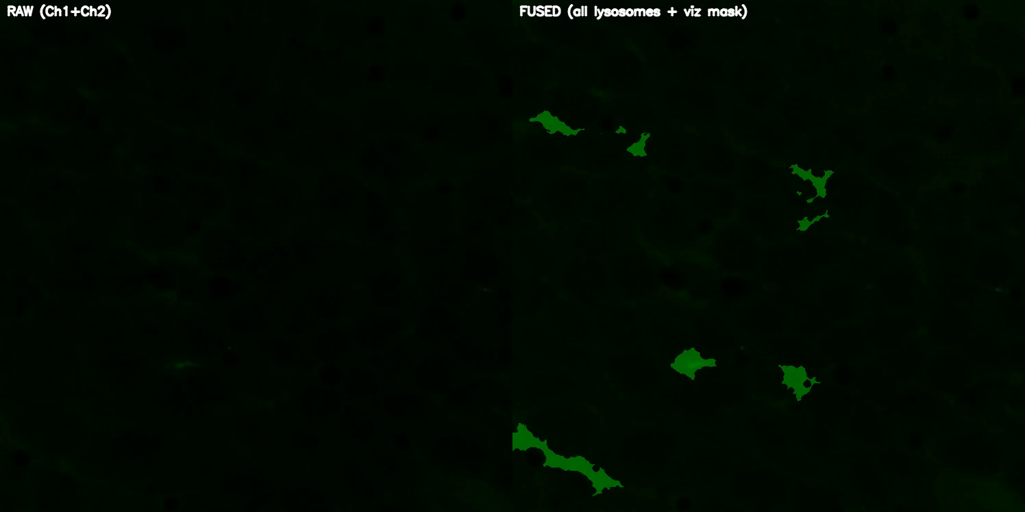
DETECTION VIDEO

Slide 5
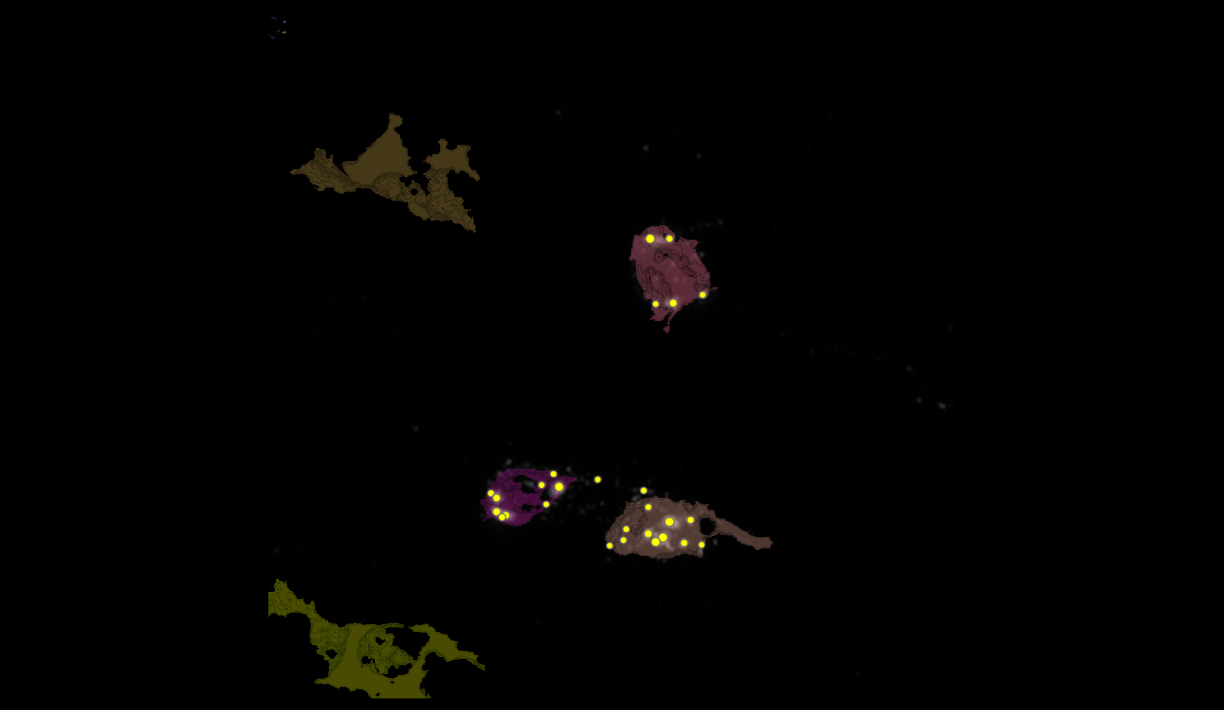
SEGMENTATION
78
151
148
155

Slide 6
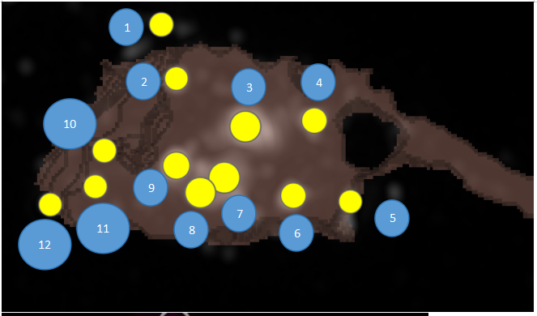
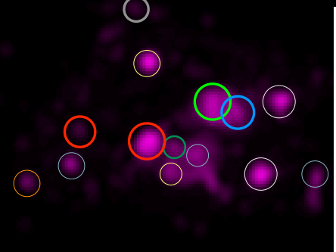
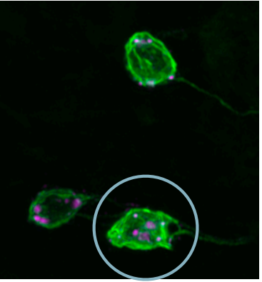
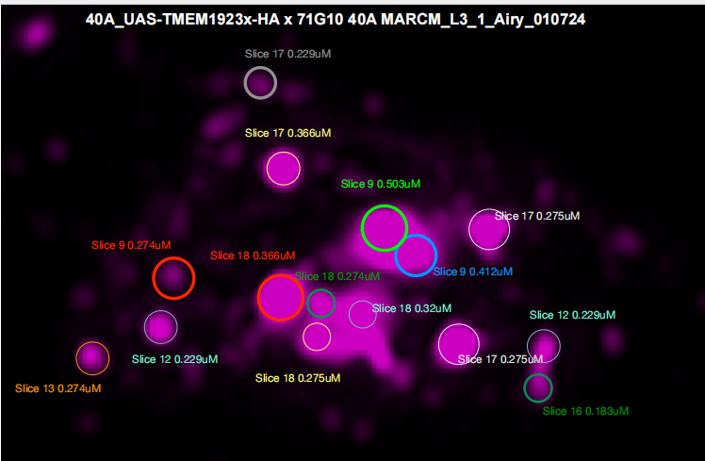
MANUAL.vs.AUTOMATIC
1
3
2
4
10
9
7
11
12
8
6
5

Slide 7
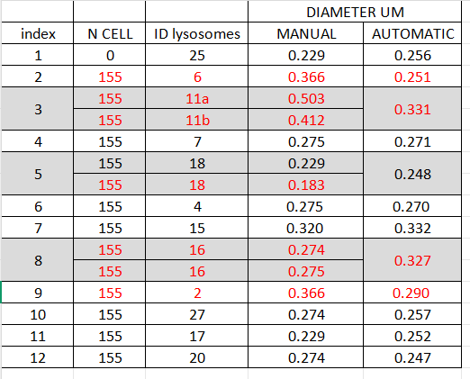
MANUAL.vs.AUTOMATIC

Slide 8
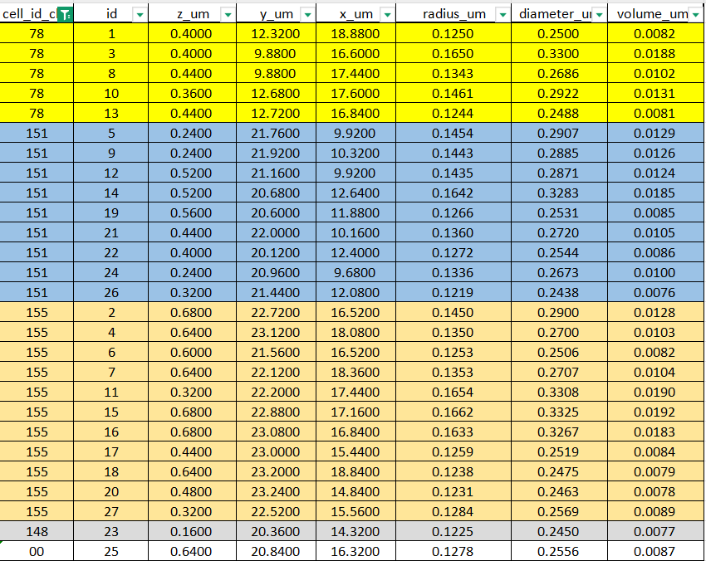
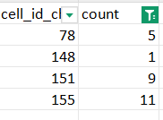
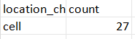
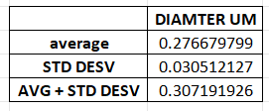
DATASET LYSOSOMES(ORDER FOR CELL ID)

Slide 9
TMEM-HA 6h CB airy_3_170722

Slide 10
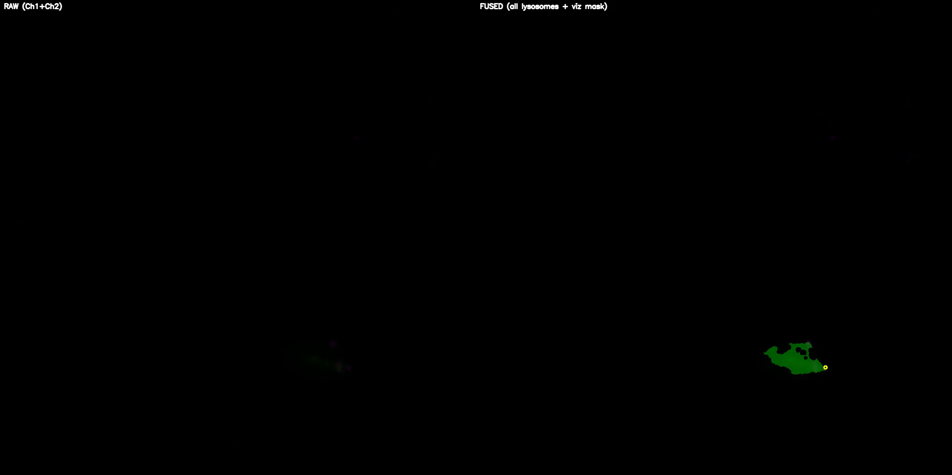
DETECTION VIDEO

Slide 11
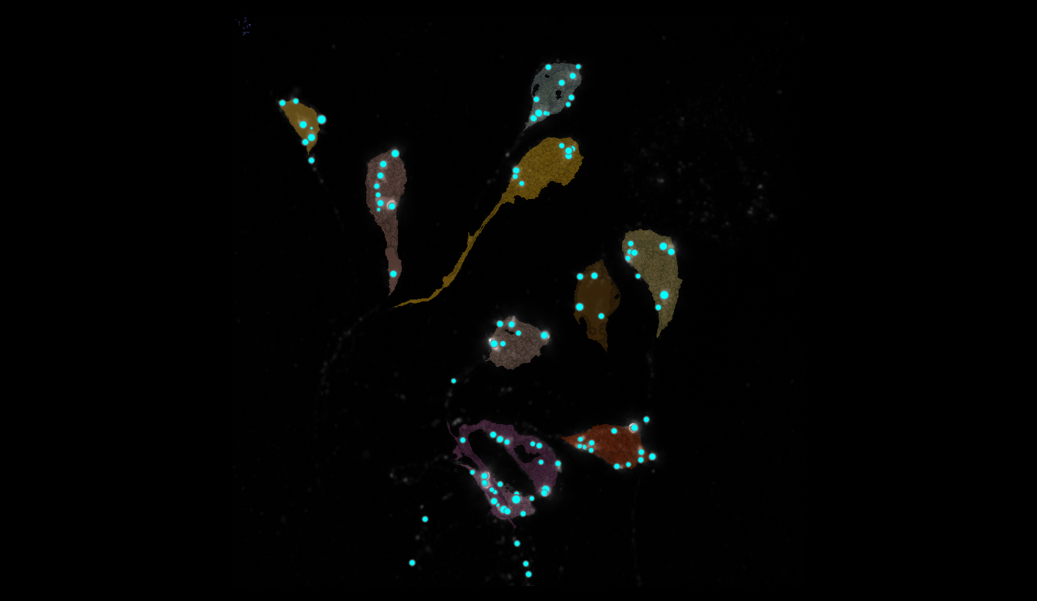
SEGMENTATION
24
2
9
8
6
7
15
1
3
5

Slide 12
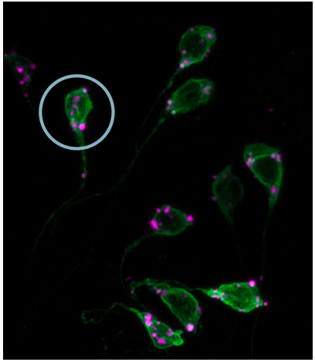
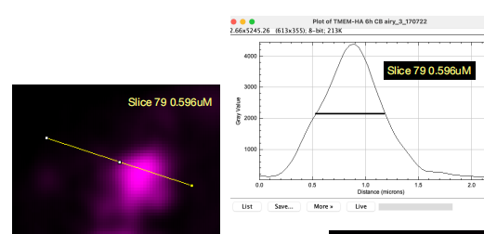
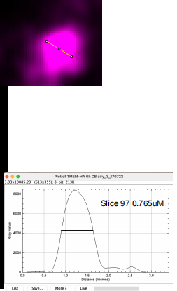
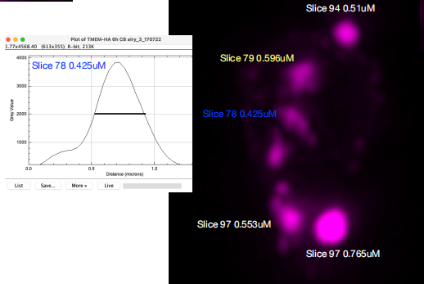
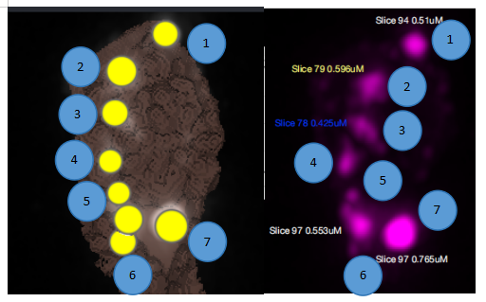
MANUAL.vs.AUTOMATIC

Slide 13
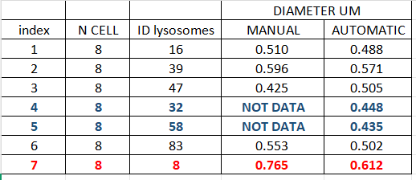
MANUAL.vs.AUTOMATIC

Slide 14
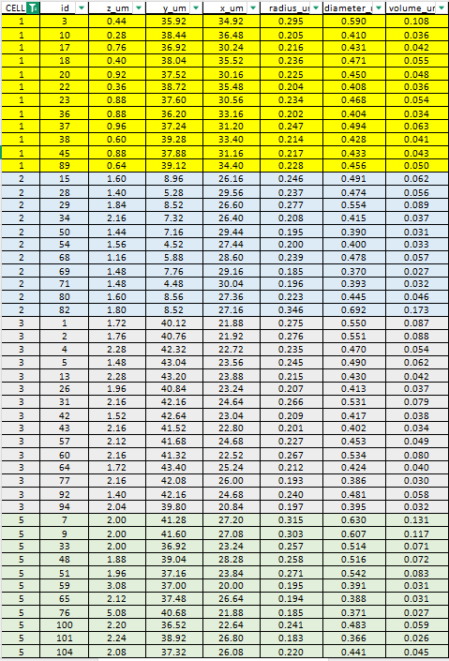
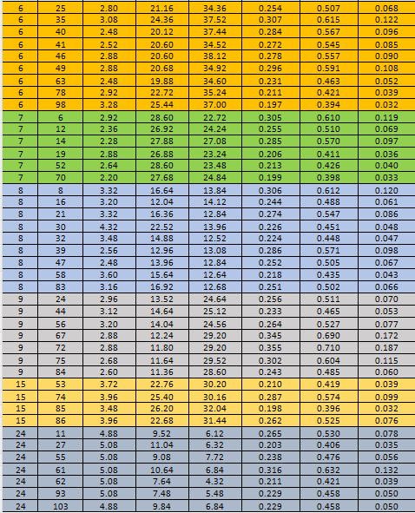
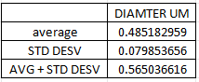
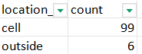
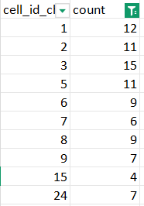
DATASET LYSOSOMES(ORDER FOR CELL ID)

Slide 15
40A_UAS-TMEM192-3xHA x 40A 71G10 MARCM_around 12h - for quantification_4 Airy-CBs_300425

Slide 16

DETECTION VIDEO

Slide 17
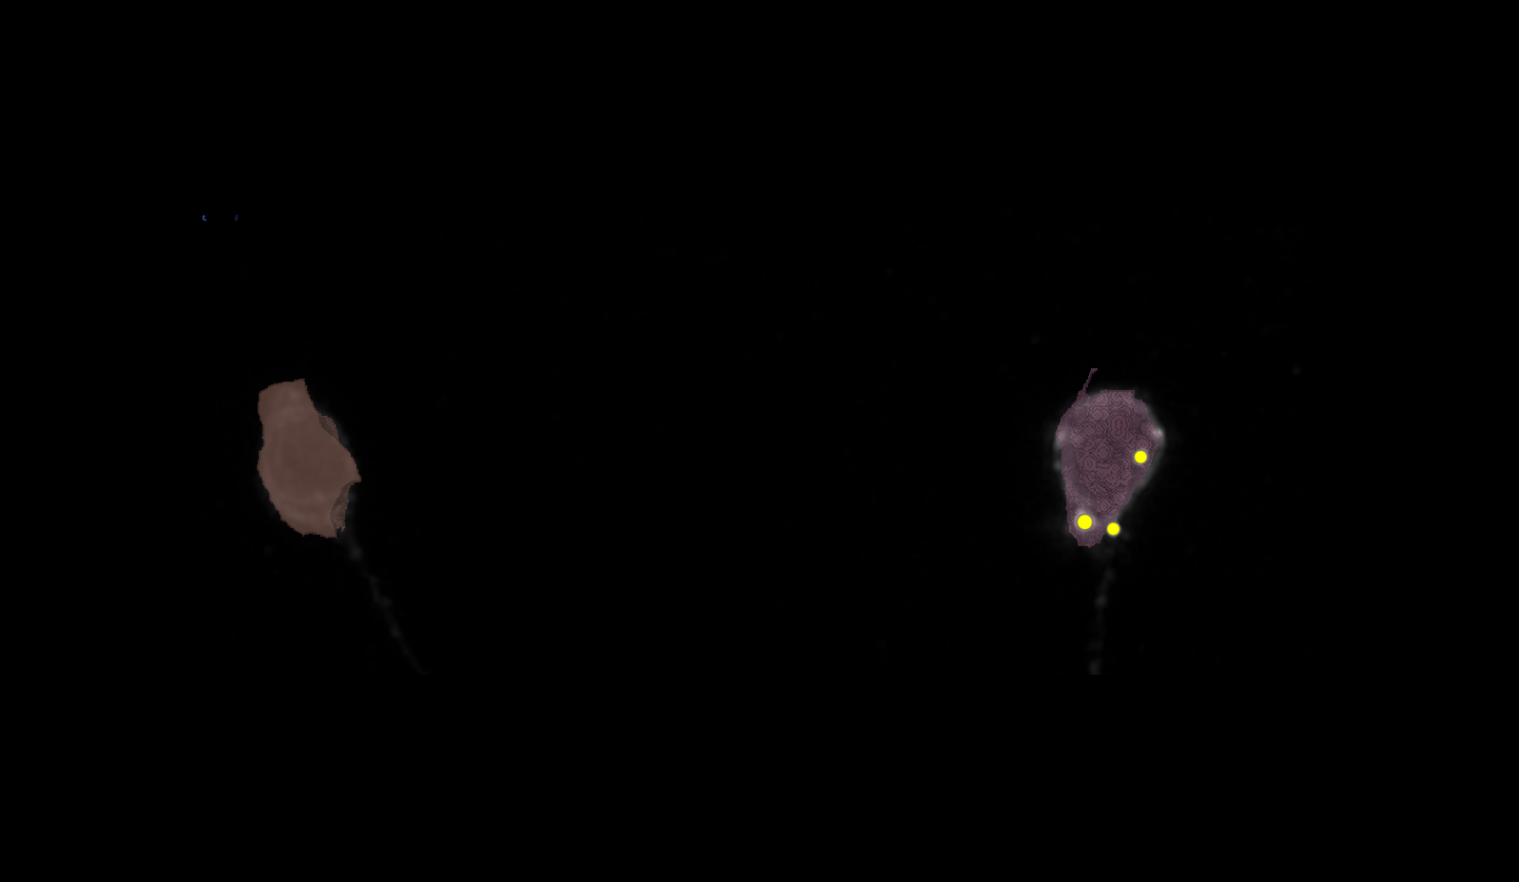
SEGMENTATION

Slide 18
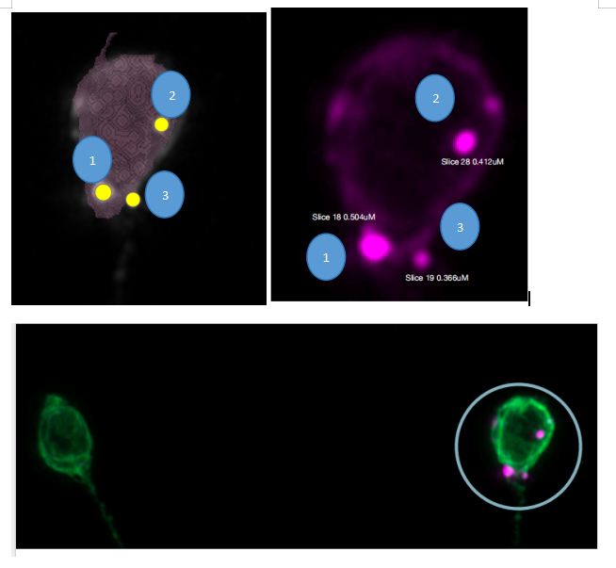
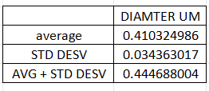
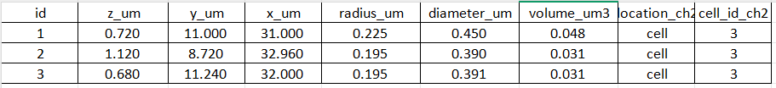
MANUAL.vs.AUTOMATIC + DATASET LYSOSOMES
1 CELL, 3 LYSOSOMES
N CELL | ID LYSOSOMES | MANUAL DIAMETER UM | AUTOMATIC DIAMETER UM
3 | 1 | 0.504 | 0.45
3 | 2 | 0.412 | 0.39
3 | 3 | 0.366 | 0.391

Slide 19
40A_UAS-TMEM192-3xHA x 40A 71G10 MARCM_around 12h - for quantification_3 Airy-CBs_300425

Slide 20
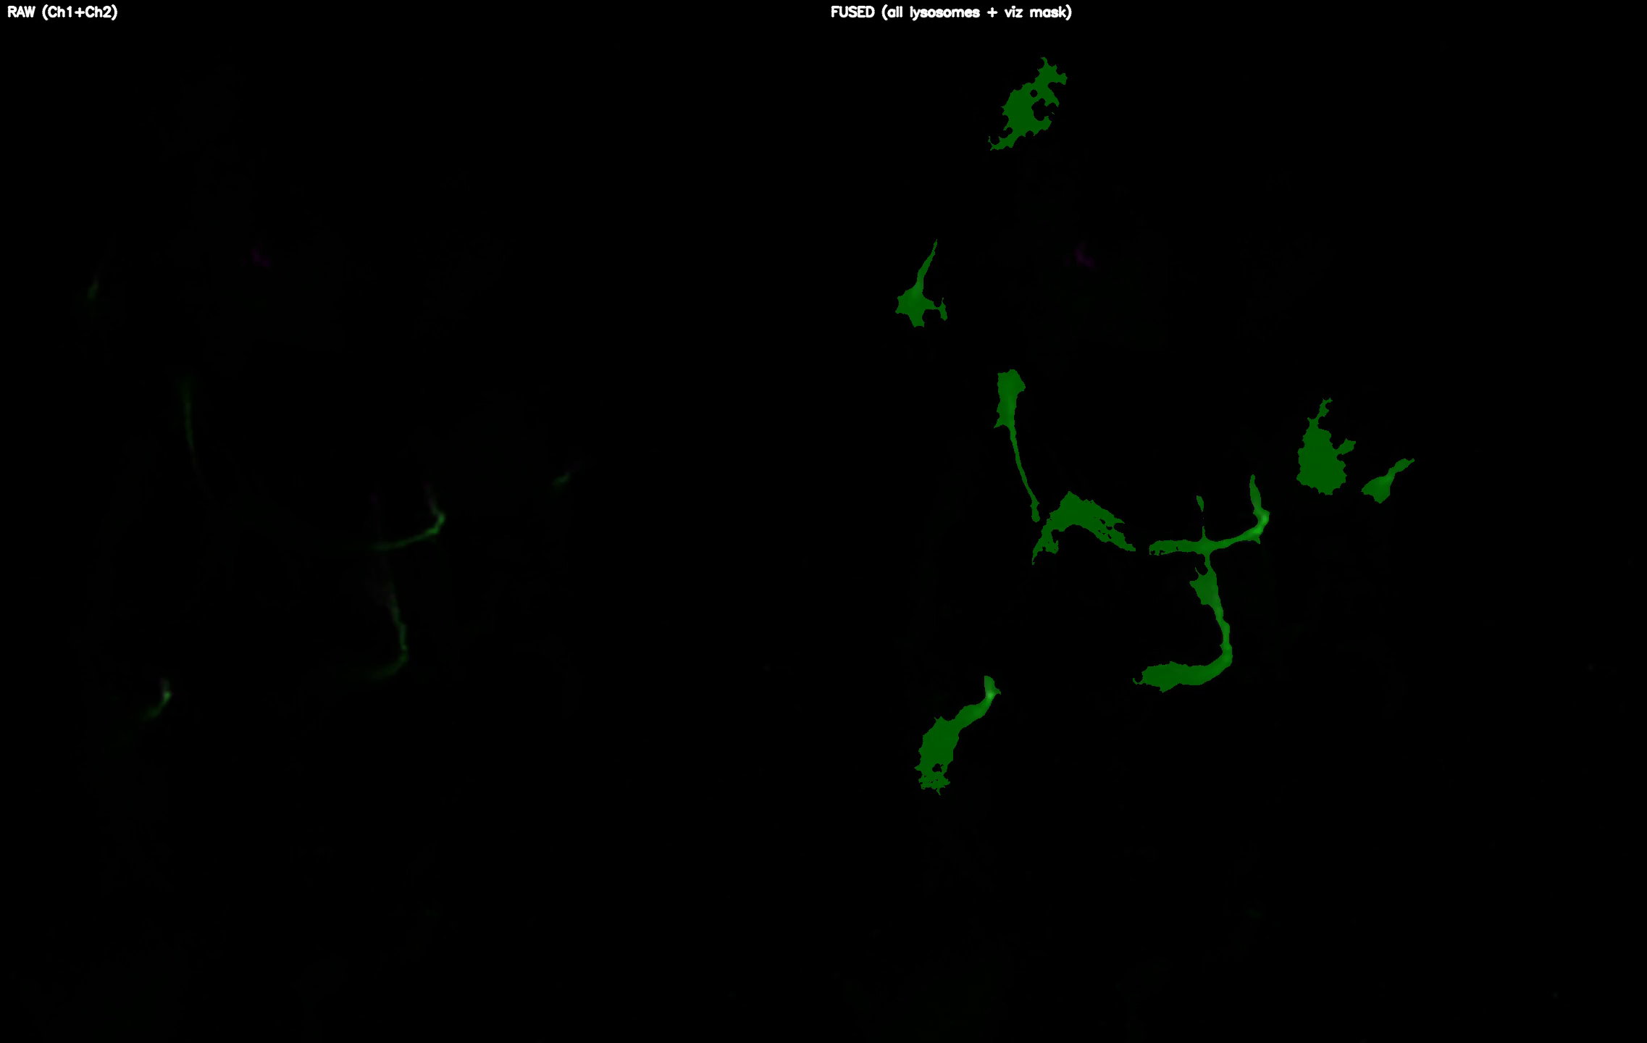
DETECTION VIDEO

Slide 21
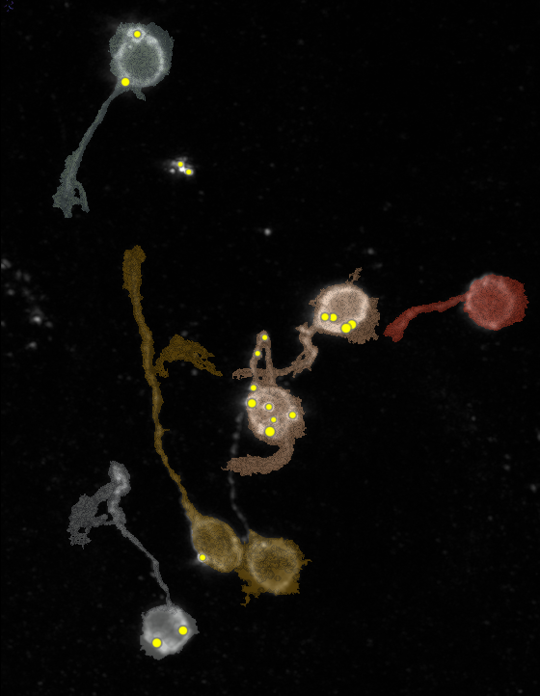
SEGMENTATION
2
18
35
39
38
65

Slide 22
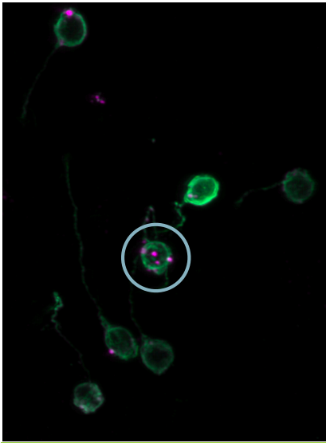
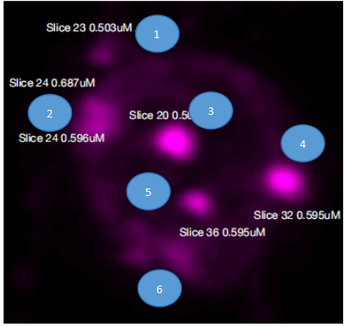
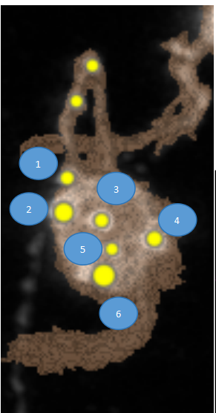
MANUAL.vs.AUTOMATIC

Slide 23
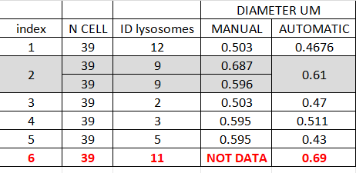
MANUAL.vs.AUTOMATIC

Slide 24
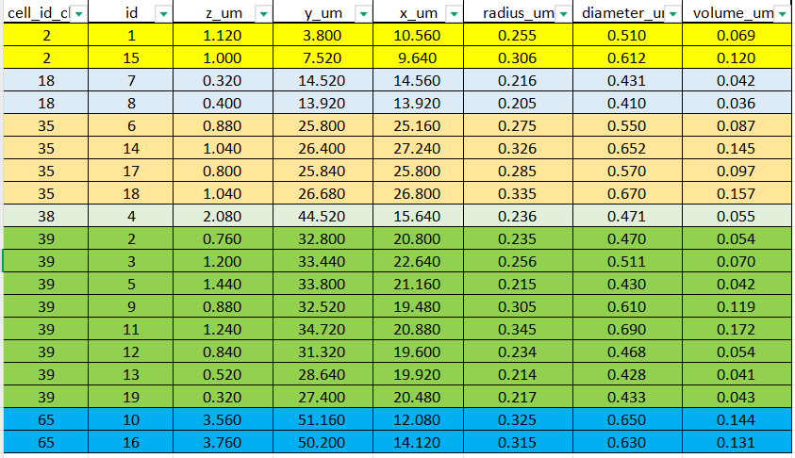
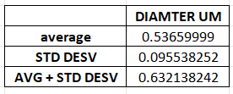
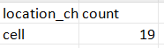
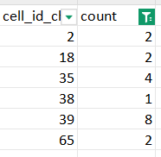
DATASET LYSOSOMES(ORDER FOR CELL ID)

Slide 25
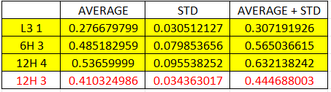
DATA ALL IMAGES
I used the image of 12H 4 and excluded that of 12H 3 because it only has one cell and 3 lysosomes, whereas 12H 4 has more cells and lysosomes, so it seemed more representative for the graph.

